Slide 1




WELCOME

Slide 2
A.K.M.I.Khairul Alam
Senior Teacher
New Model Multilateral High School
Sukrabad, Dhaka -1207
Class: Nine
Subject: Physics

Slide 3


What is happening here?
Think about this event

Slide 4


Newton’s third law of motion
What you have seen in this event?
What you have seen in this event?

Slide 5
Learning outcomes
By the end of this lesson students’ will be able to
say Newton’s third law of Motion
explain conservation of momentum
prove the principle of Momentum Conservation.

Slide 6

Is there any force working?
Now you see How it works.
Newton’ third Law of Motion.
For every action,
there is an equal
and opposite reaction

Slide 7

What is happening here. How it works?

Slide 8

 | Before | After | Change
Kamal
Jamal
Total
Tk 5000
Tk 4500
- Tk 500
Tk 4000
Tk 4500
+Tk 500
Tk 9000
Tk 9000
0

Slide 9
Momentum Conservation Principle
For a collision occurring between two objects in
an isolated system, the total momentum of the
two objects before the collision is equal to the total
momentum of the two objects after the collision.

Slide 10
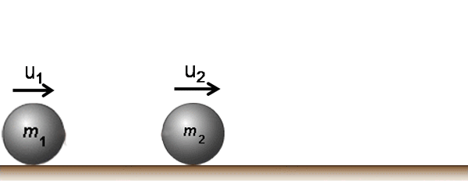

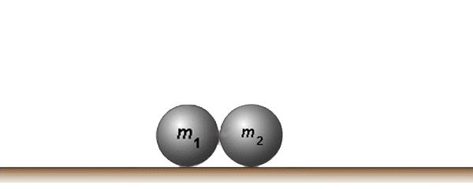
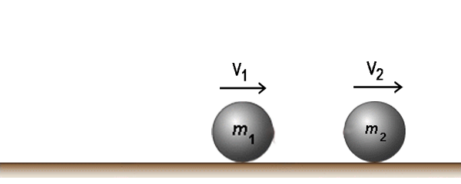
m₁u₁ + m₂u₂
m₁v₁ + m₂v₂
F₂
F₁

Slide 11

Group Work
Explain the event that is shown above.

Slide 12
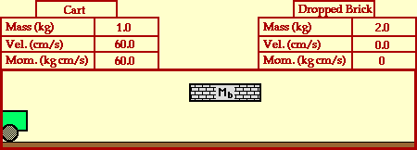
Evaluation
Say Newton’s third law of Motion.
From the following event find the velocity
of the van after bricks dropped into it.

Slide 13
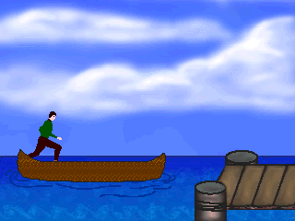
Home Work
While jumping from the boat into the
river bank the boat goes back – Explain it.

Slide 14
Thank you all

